Slide 1
Use eIQ® toolkit to train model and deploy it on i.MX 93
Subheading or speaker name
If required goes here | speaker title, date and/or additional information

Slide 2
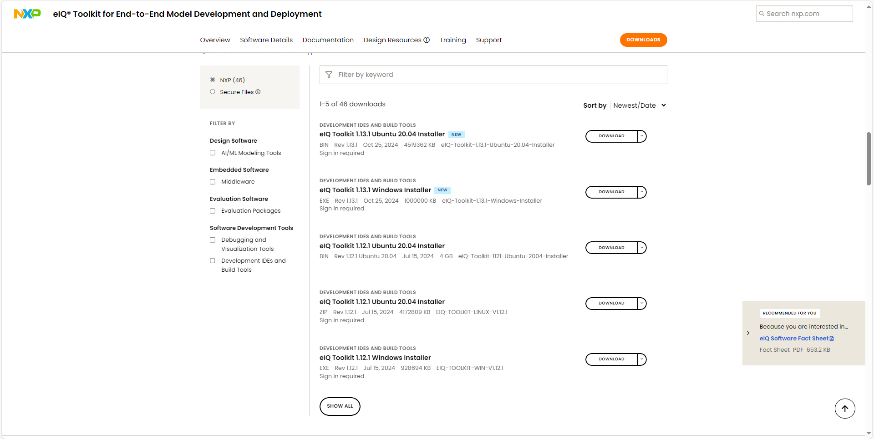
Download the eIQ® toolkit based on your OS
LINK

Slide 3
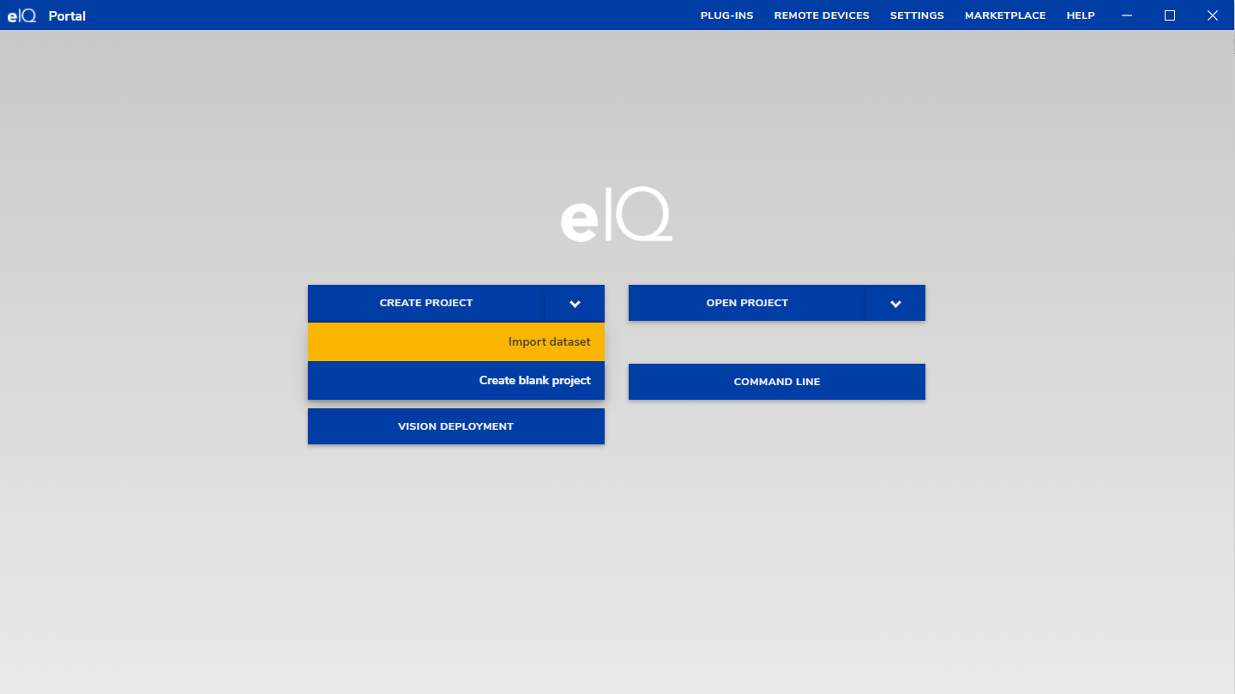
Lauch the eIQ® toolkit
We could create a new project by clicking on CREATE PROJECT or open an existing one by clicking on OPEN PROJECT.
I choose to create project and import dataset here.

Slide 4
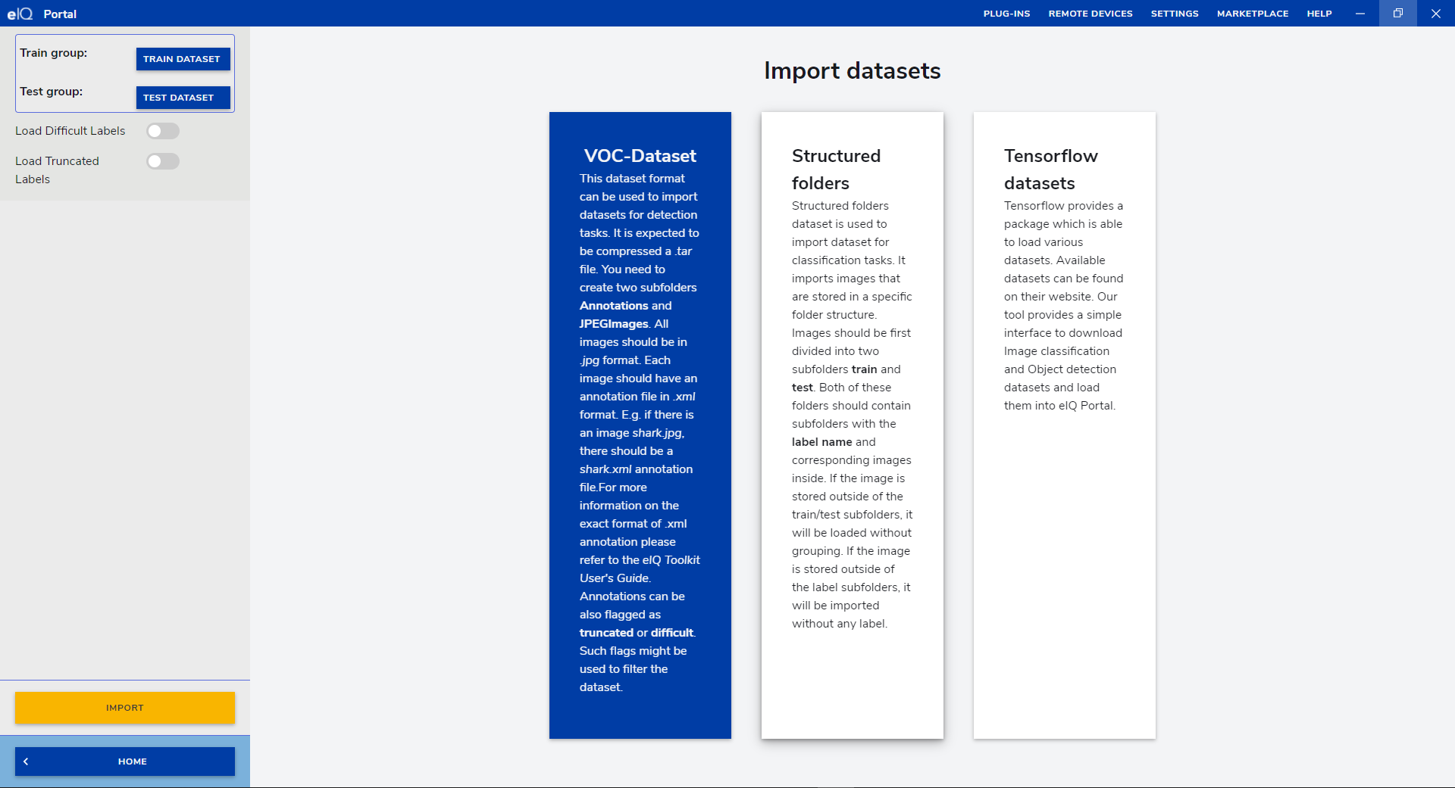
Import Dataset
And I choose to import VOC dataset.

Slide 5
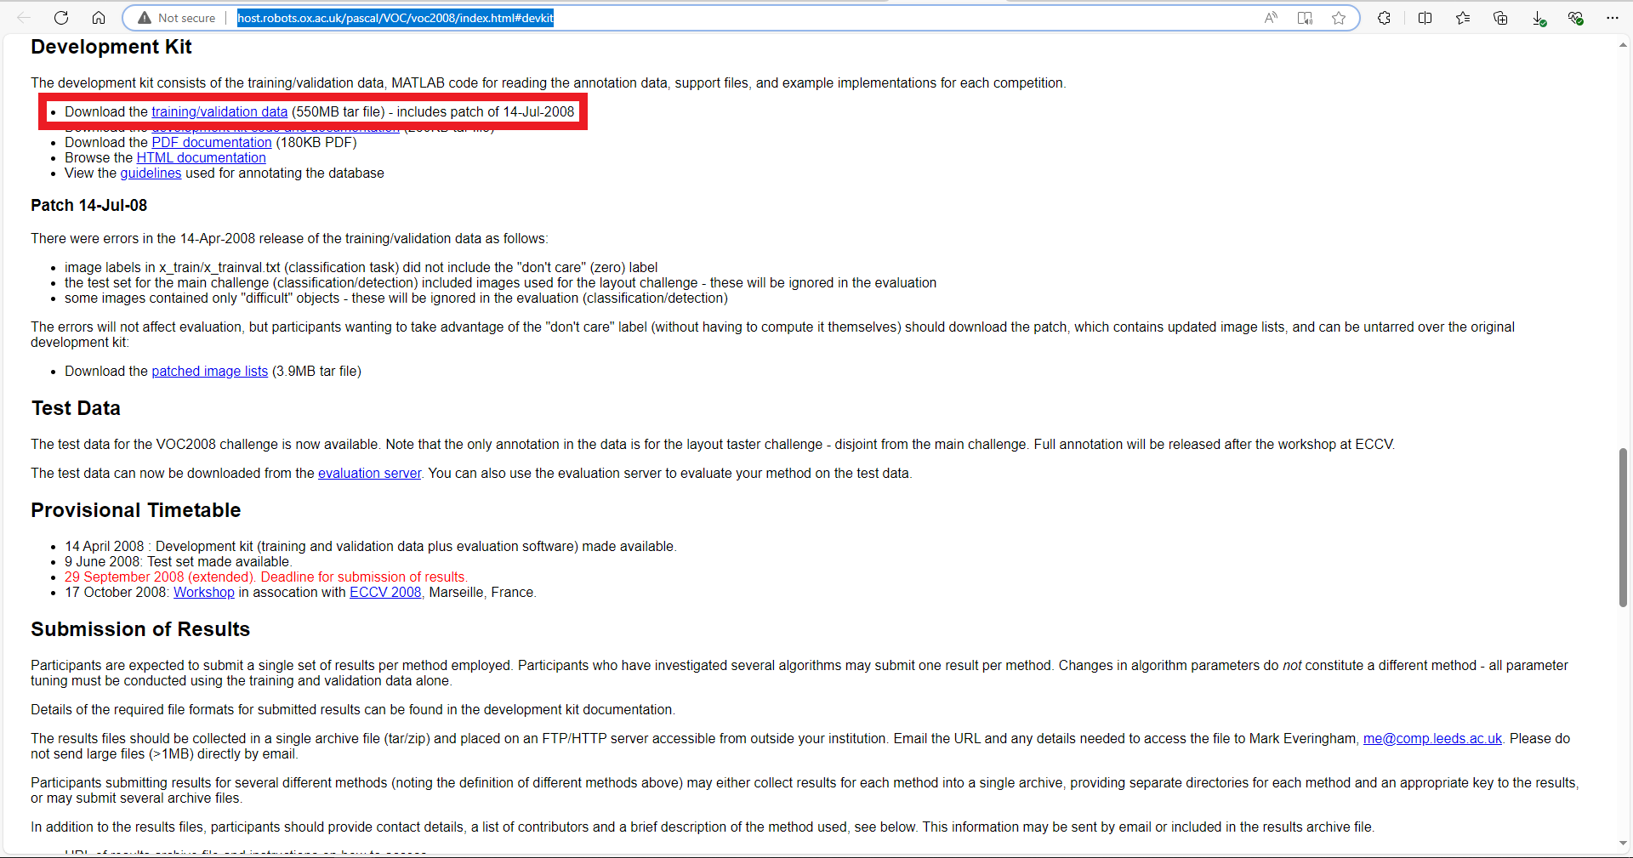
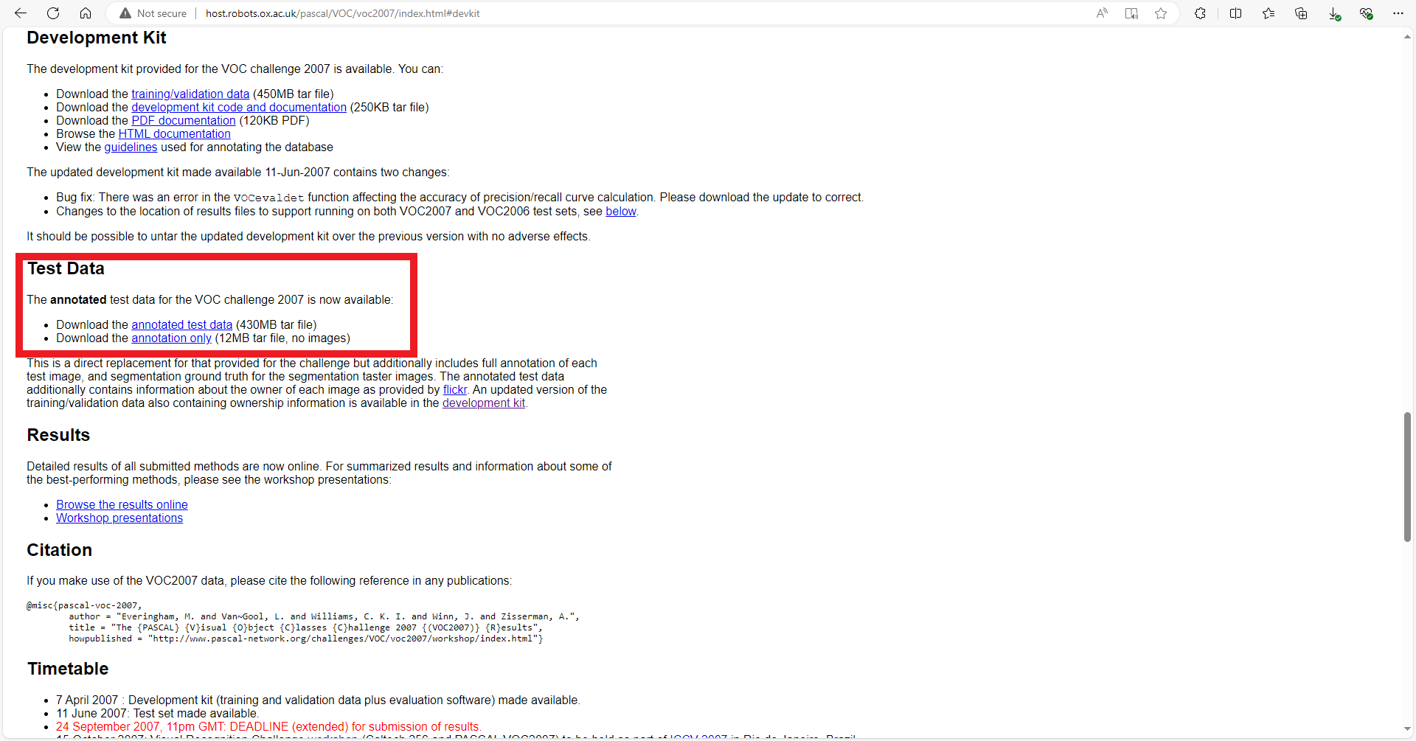
Import Dataset
We could download the dataset from the links.
Download the data for training and validation.
Download the data for test.

Slide 6
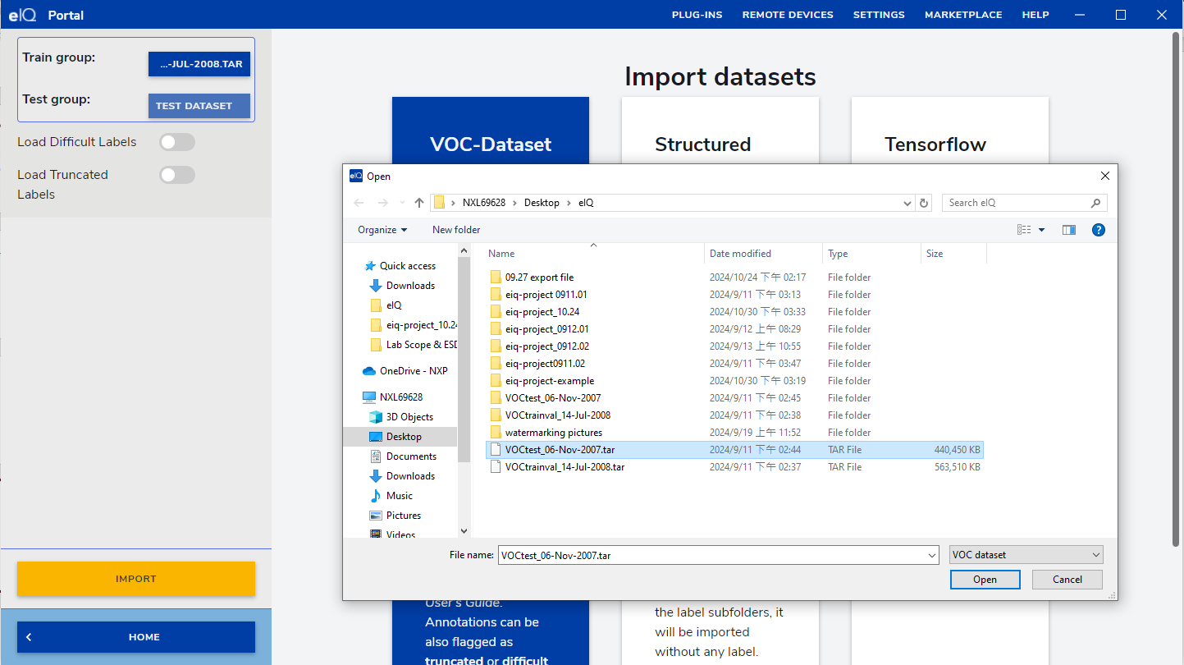
Import Dataset
Import the dataset after downloading them.
‘Load difficult labels’ and ‘truncated labels’ are optional.

Slide 7
Import Dataset
We could import other dataset by following the Chapter 3.3 in the eIQ Toolkit User Guide.
Creating and Importing Custom VOC Datasets on Chap. 3.3.1.2.
Structured Folders Dataset on Chap. 3.3.2.
TFDS Datasets on Chap. 3.3.3.
Writing a Custom Script to Create a Dataset on Chap. 3.3.4.

Slide 8
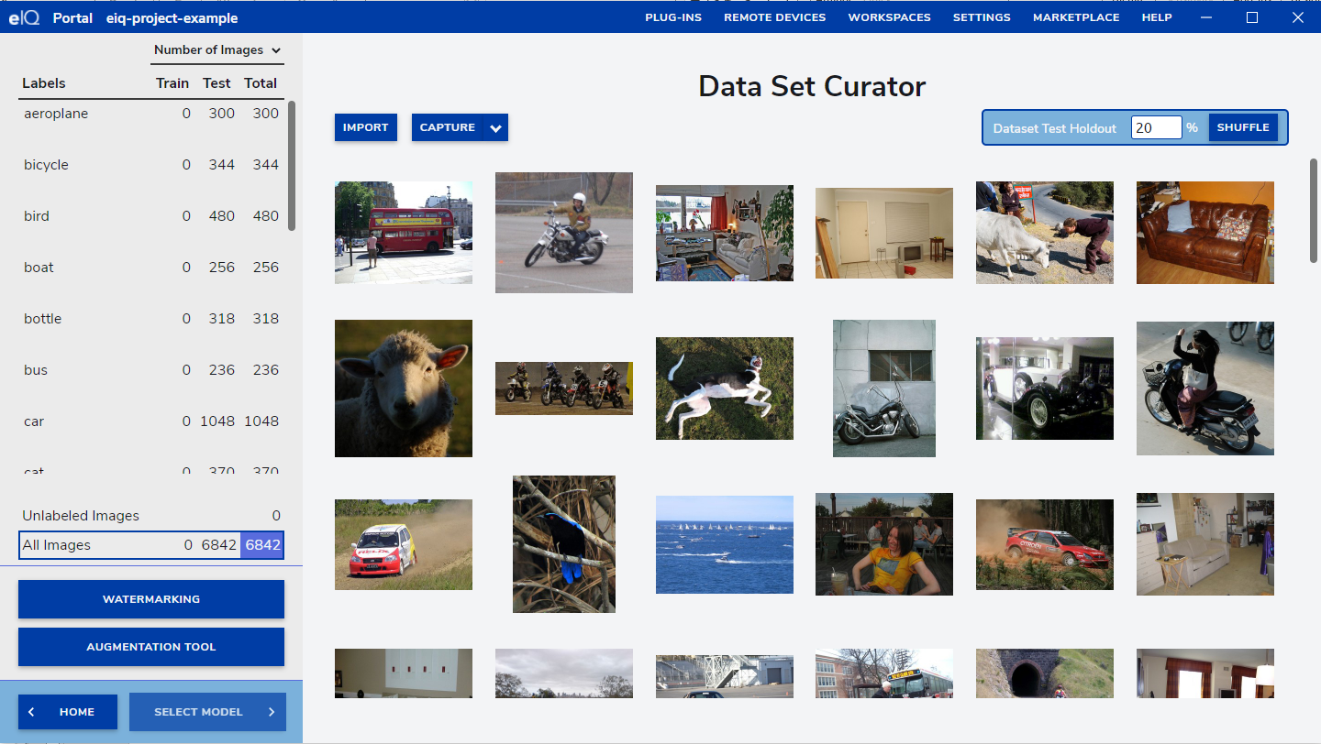
Import Dataset
After importing the dataset, we could see screen like below.
‘Adjusting the Test Holdout percentage’ and ‘Augmentation for the dataset’ are optional.

Slide 9
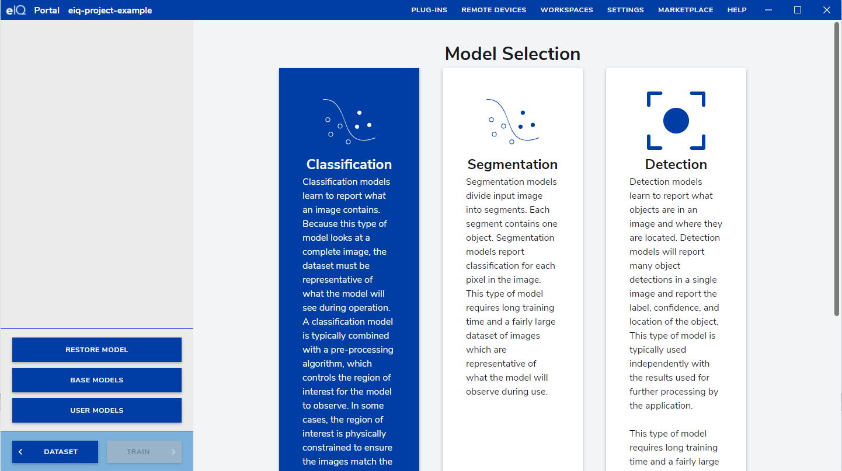
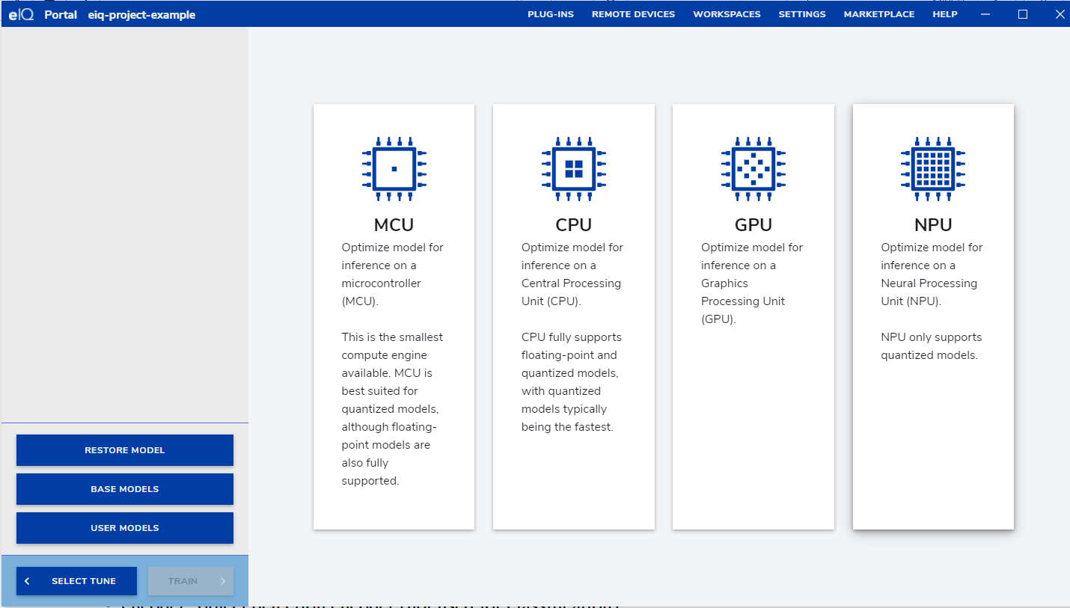
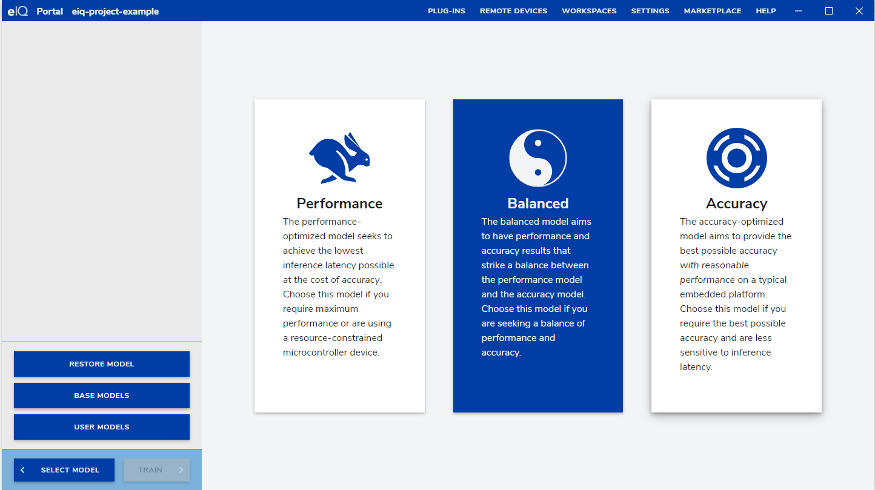
Select Model
Select the model, mode and target based on your application.
Here, I choose classification, balanced mode, and NPU.

Slide 10
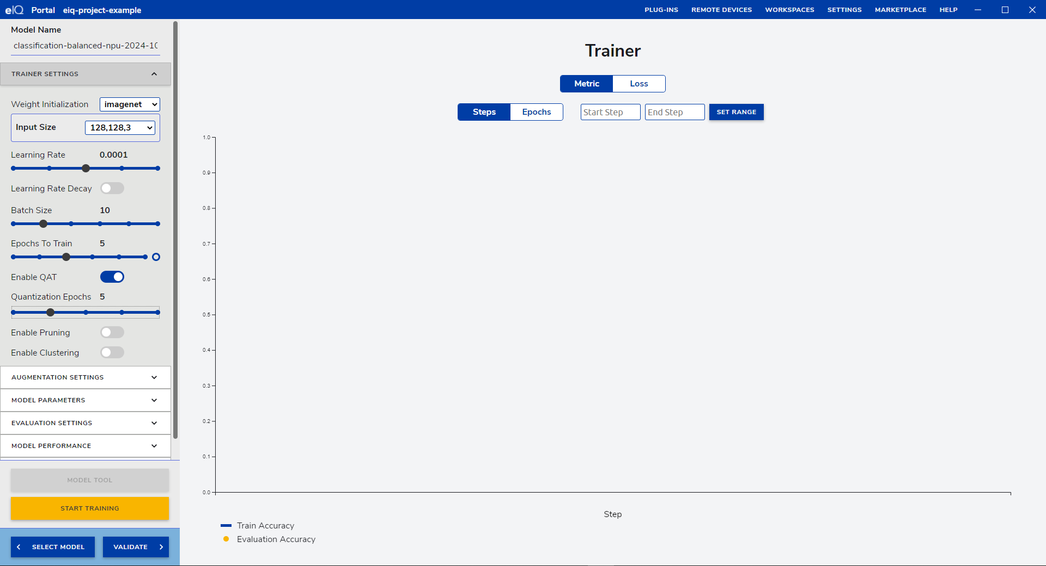
Set Hyperparameter and Start Training
Here, I set
Input size: 128, 128, 3
Learning Rate: 0.0001
Batch Size: 10
Epochs to Train: 10
Enable QAT(Quantization Aware Training)
Quantization Epochs: 5

Slide 11
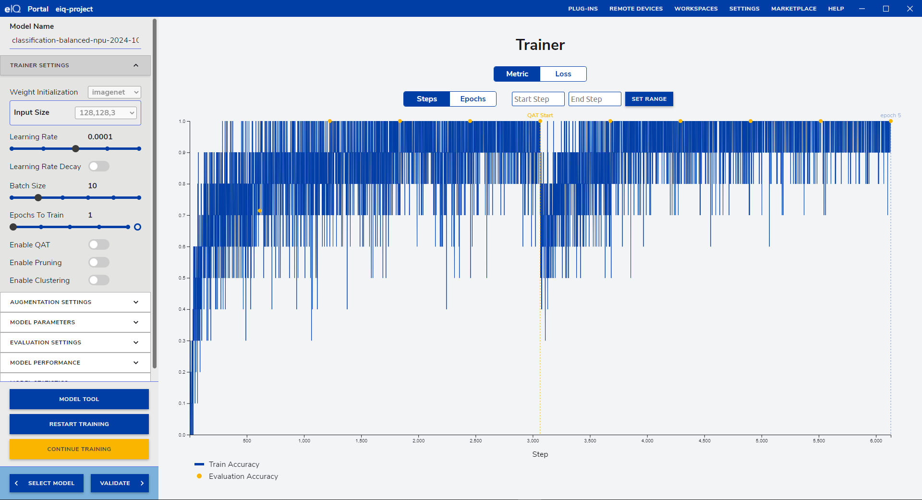
Complete Training Phase
After Training, we could see the screen like below.

Slide 12
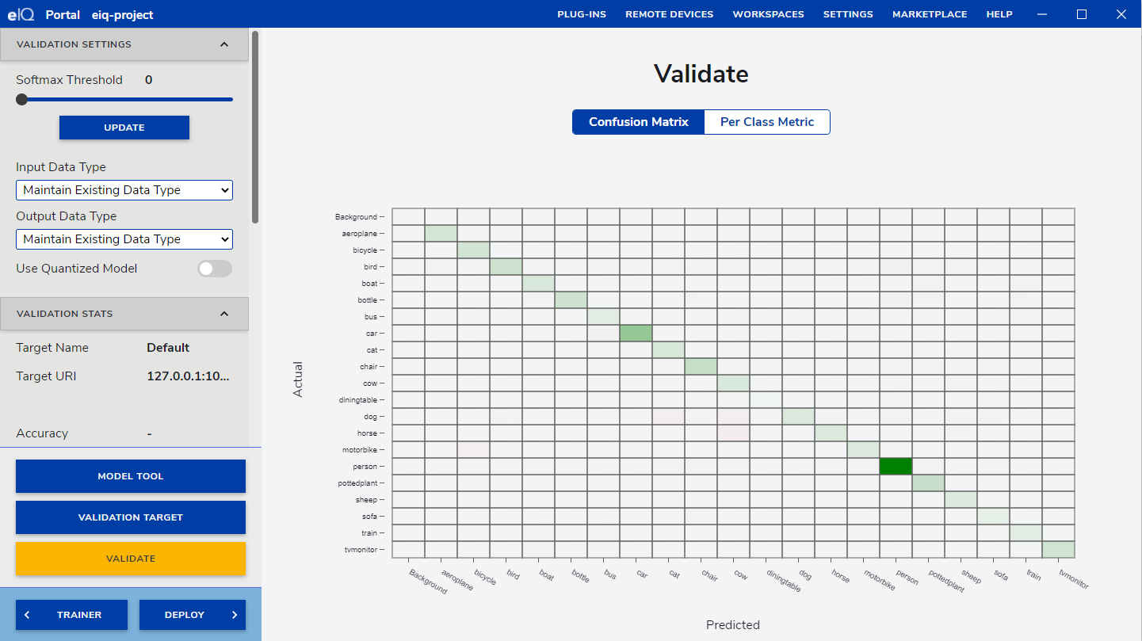
Validate the model you trained

Slide 13
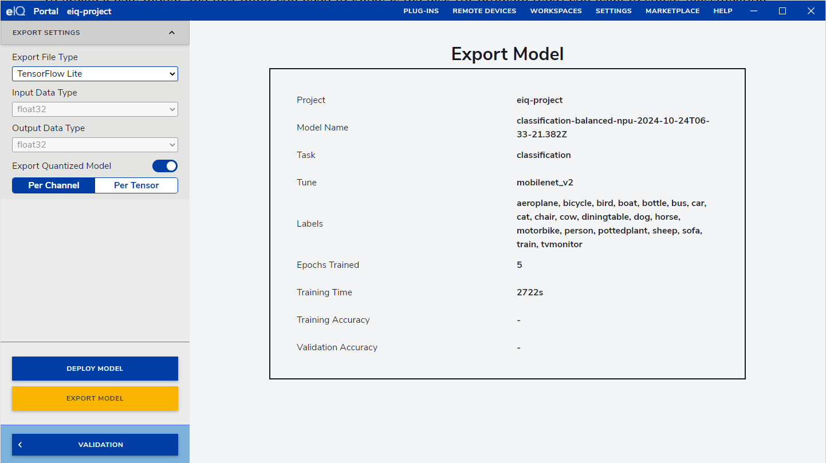
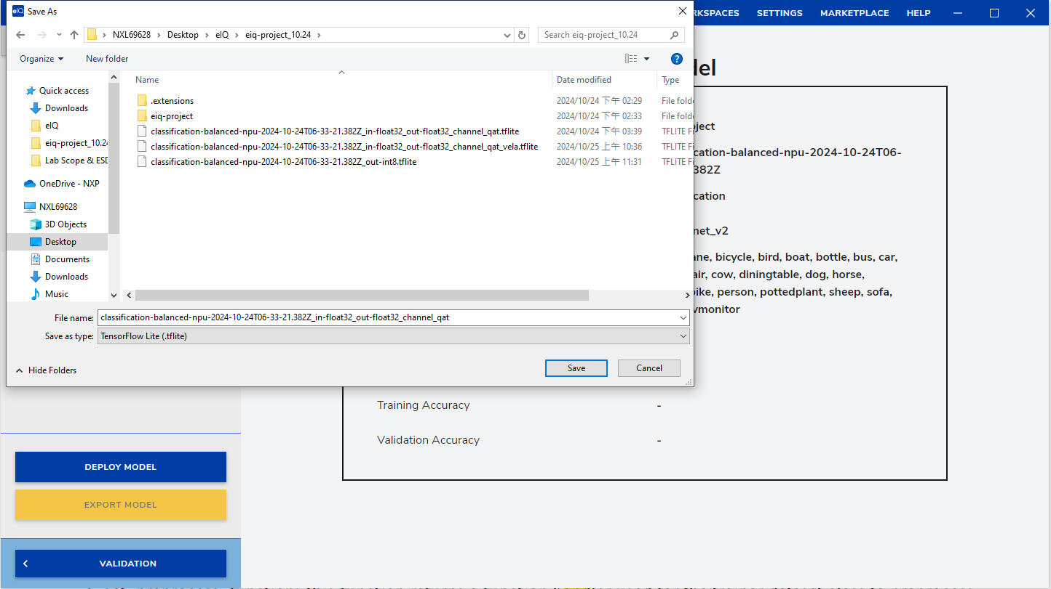
Export the model
Click on the DEPLOY and choose the file type we would like to export.
Here, I choose to export TensorFlow Lite File and Quantized Model.

Slide 14
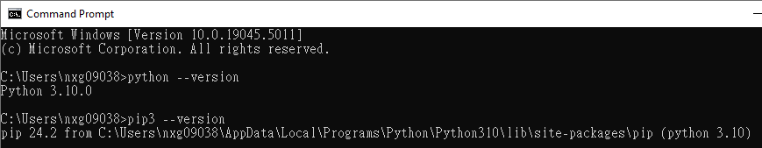
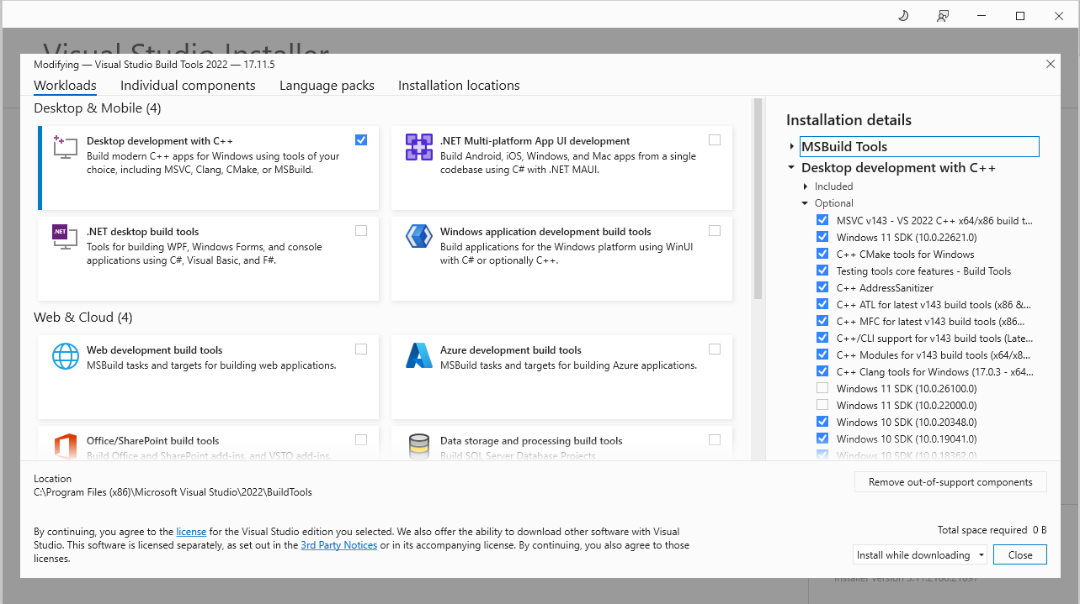
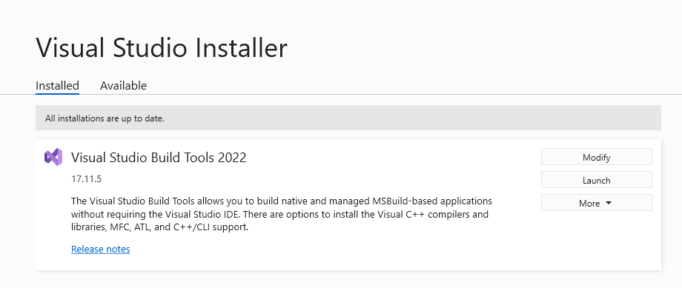
Install Arm-Vela and Create an .tflite file specially for NPU acceleration
The following should be installed prior to the installation of Vela
Check if python and pip3 have been installed.
Install C99 capable compiler and associated toolchain.
For Microsoft Windows 10, the Microsoft Visual C++ 14.2 Build Tools are recommended.
Open Visual Studio Installer
Modify Visual Studio Build Tools you installed
Check if you have installed the build tools
Reference Link

Slide 15
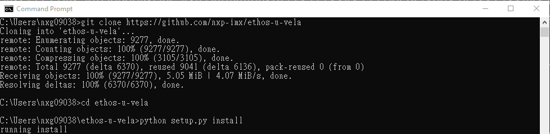
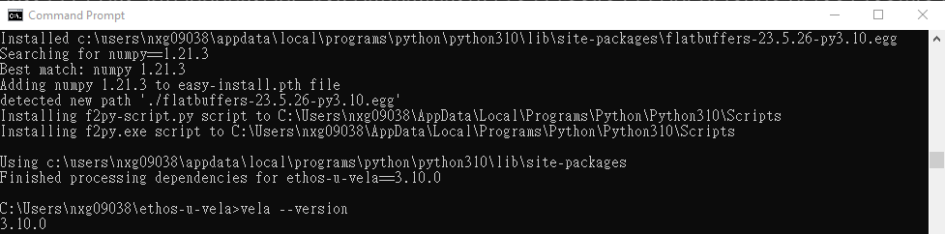
Install ARM-Vela and Create an .tflite file specially for NPU acceleration
Git Clone the package and Install ARM-Vela
Reference Link

Slide 16
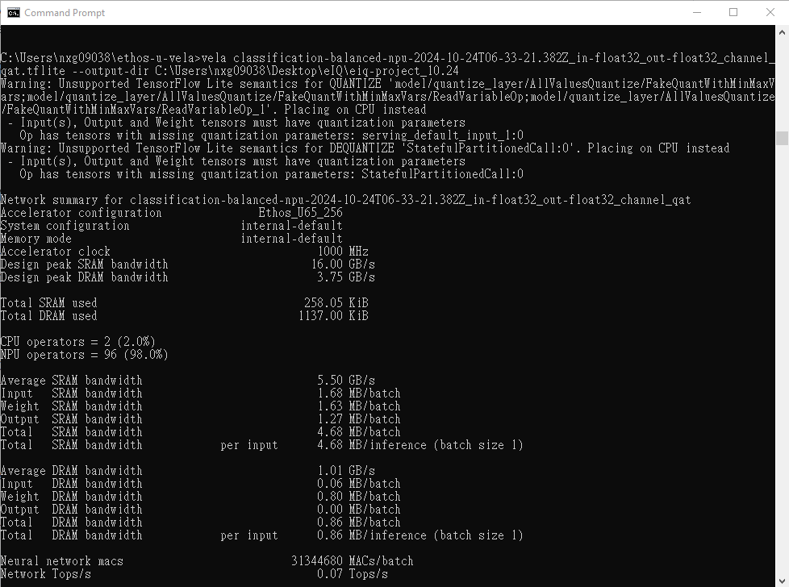
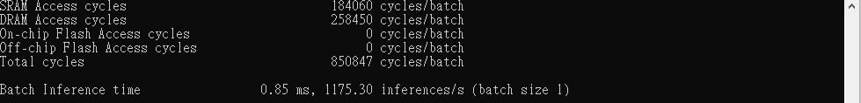
Install ARM-Vela and Create an .tflite file specially for NPU acceleration
Optimize previous .tflite file with ARM-Vela
Reference Link

Slide 17
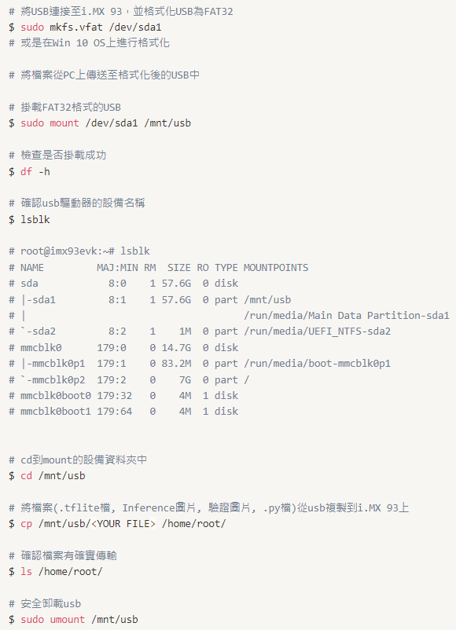
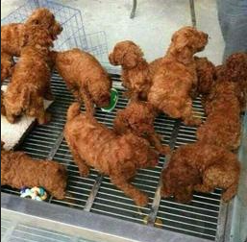
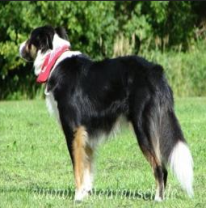
Use USB to transfer the files
Remember to FORMAT USB to FAT32
Here, I transfer six files:
.tflite file
_vela.tflite file
run_model.py
requirements.txt
dog-256x256.jpg (To Inference)
dog000018-256x256.jpg (To Validate)
We could access these files from: Github Link

Slide 18
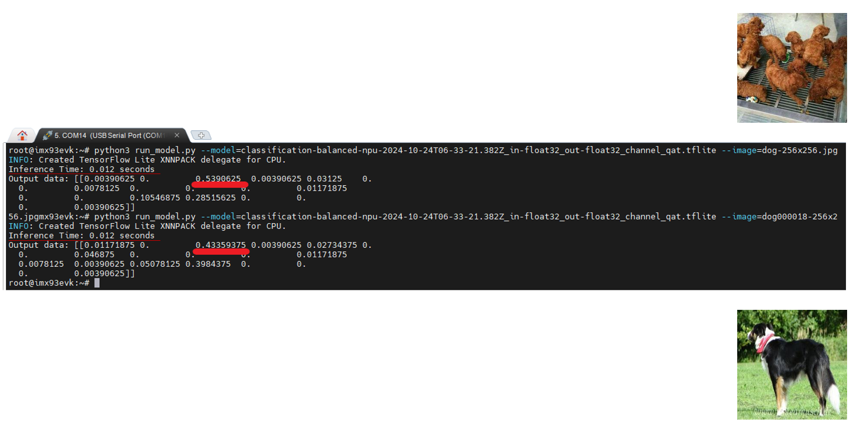
Run the model on CPU
$ python3 run_model.py --model=<YOUR MODEL NAME> --image=<IMAGE NAME>

Slide 19
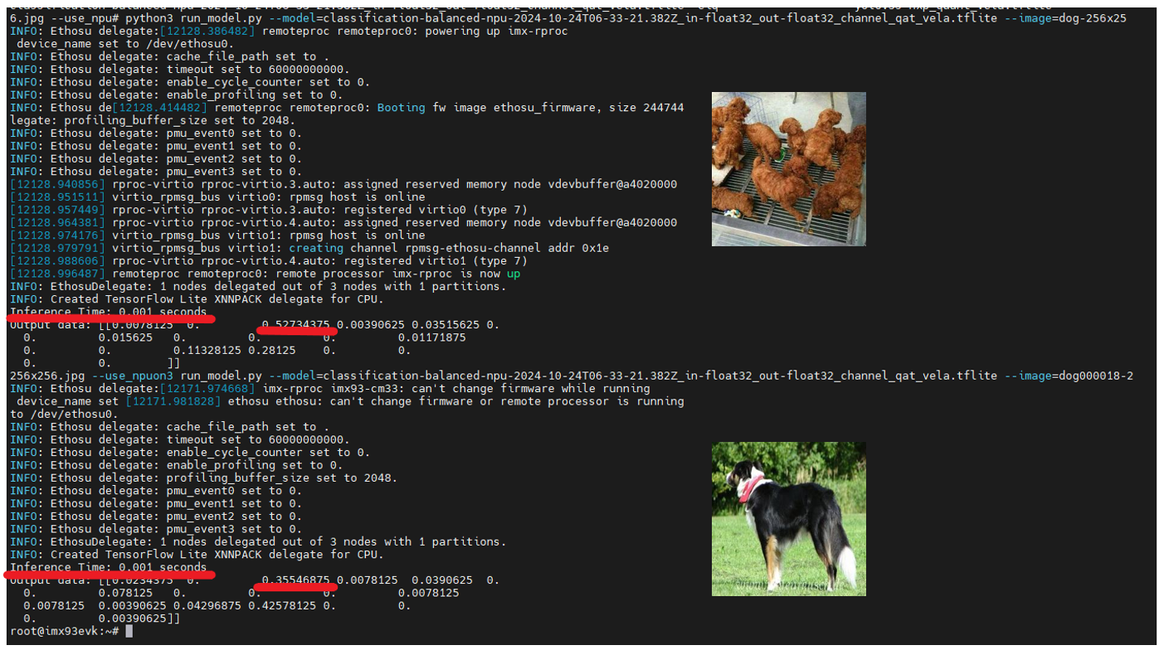
Run the model on NPU
$ python3 run_model.py --model=<YOUR MODEL NAME> --image=<IMAGE NAME> --use_npu

Slide 20
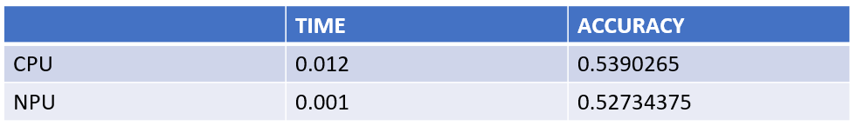
Compare the result
Improved by 91.67%
Decreased by 2.17%

